Slide 1
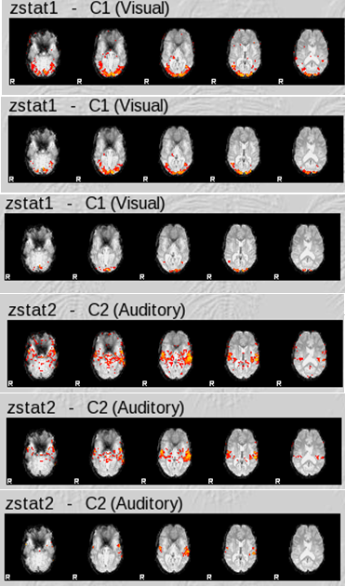
Thresholding using FEAT
David Field
Thanks to….
Tom Johnstone, Jason Gledhill, FMRIB
Notes:
Top image – visual and auditory activation from week 2 practical thresh is 0.01 voxelwise uncorrected
Middle image – 0.001 uncorrected voxelwise and then 0.05 clusterwise FWE
Bottom image – 0.05 FWE voxelwise

Slide 2
Overview
What is being thresholded?
Multiple comparisons problem in FMRI
Dealing with the multiple comparisons problem
  FWE control and other approaches
Reproducibility of FMRI experiments
________________________________________
Writing FSL scripts and batch files in Linux

Slide 3
Thresholding – the starting point
Each COPE is divided by a VARCOPE to produce a volume of t statistics
  remember that the simplest COPE image is equal to a PE image (the effect size for one column of the design matrix)
t is a measure of estimated effect size relative to the degree of uncertainty of the estimate
  A large t arises from a large effect size, a small amount of uncertainty, or both at once
FSL converts t to z prior to thresholding
  large z is the same as large t

Slide 4
Intuitive thresholding
Voxels where the z is larger than 1 have COPE effect sizes where the signal of interest is greater than the estimate of the noise
If z is > 3 there is usually an effect of interest present
Open an unthresholded zstat image in FSLVIEW and manually threshold it
  note that the negative values of z have the same interpretation except that the COPE value is negative, so the direction of effect is reversed
  conventionally, to look at these negative values you reverse the COPE to make them positive (e,g. -1 instead of 1)

Slide 5
Formal thresholding – converting t to a p value
The data you have is a sample from a population of possible data sets of the same size
Assuming the truth of the null hypothesis, that the mean value of the COPE in the underlying normally distributed population is zero with some standard deviation
  what is the probability of a sample of this size producing a COPE of the obtained size just by random sampling from the null distribution?
Given the DOF, t can tell you this probability at each voxel
It is conventional to declare a result “statistically significant” if p < 0.05
  the chosen cut off is known as α

Slide 6
Multiple comparisons problem
Using an α level of 0.05 at each voxel, with 50,000 voxels
  0.05 * 50,000 = 2500 false positive results
One solution is to control the familywise error rate (FWE)
  This means that you adjust the α of each independent test so that the risk of one or more false positives among all the tests performed is 0.05 (or other desired threshold)
The Bonferroni method is to divide the desired α by the total number of independent tests performed
  0.05 / 50,000 = 0.000001
t will have to be very large to be declared significant
Using Bonferroni would also involve making the false assumption that each voxel is independent of its neighbours

Slide 7
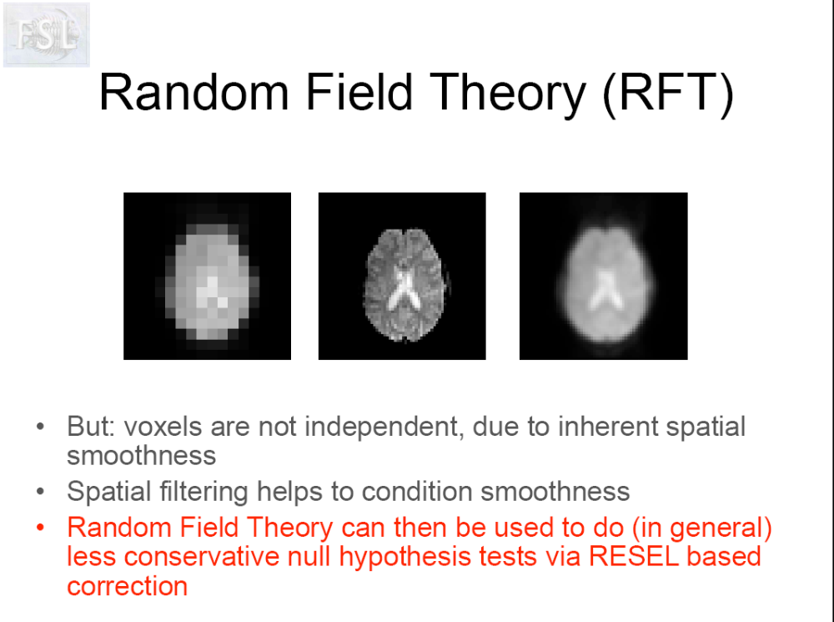
Notes:
RESEL based correction, called FWE in SPM, is just like a bonferroni correction, except, instead of dividing the desired threshold (e.g. 0.05) by the number of voxels, you divide it by the number of RESELS (resolution elements). This number is a bit like the number of independent spatial units you would expect in the image by chance, given the smoothness of the image.
FWE stands for family wise error rate, where family means all the tests you are performing.

Slide 8
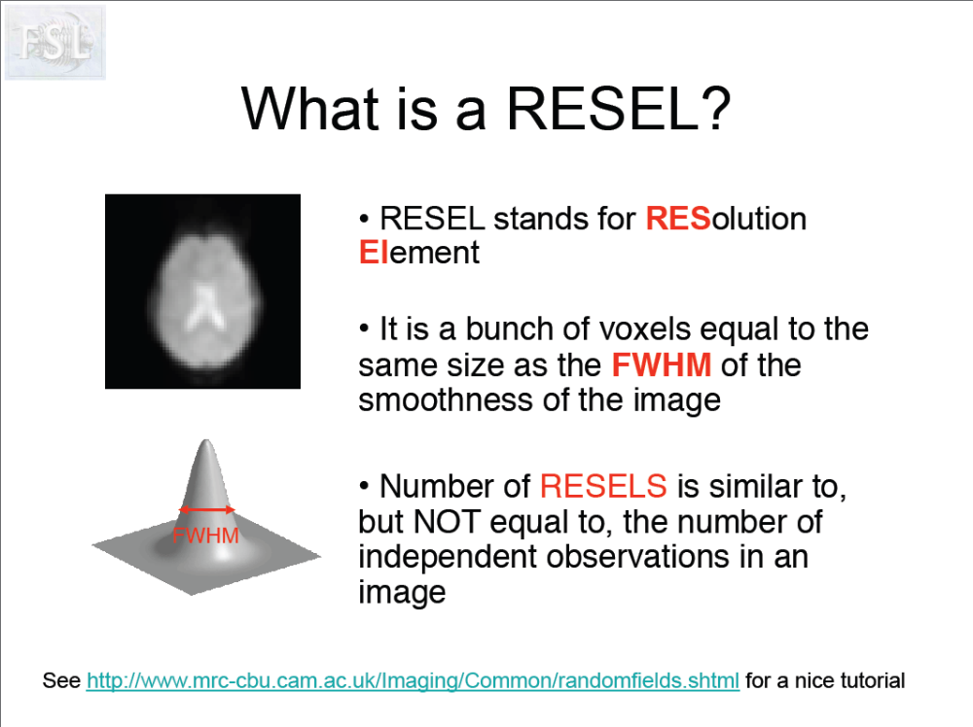
Notes:
RESEL based correction, called FWE in SPM, is just like a bonferroni correction, except, instead of dividing the desired threshold (e.g. 0.05) by the number of voxels, you divide it by the number of RESELS. This number is a bit like the number of independent spatial units you would expect in the image by chance, given the smoothness of the image.
To get FSL to correct for multiple comparison using the RESEL approach you select the voxel option on the post stats tab. If you don’t want to correct for multiple comparisons, and you just want to threshold each voxel at some level (e.g. 0.001), ignoring the number of comparisons you are making then choose “uncorrected” on the post stats tab
Note that if you have not used smoothing on your data as part of preprocessing, or you have only smoothed by 1-2 mm then the RESEL based approach will be very conservative. As smoothing also influences the other approach to thresholding the image discussed today, the cluster size approach, you can see that your choice of smoothing kernel is a very important decision…
Given that what is at stake here is really the number of independent comparisons you are making, it makes sense to scan less of the brain if you know where you will be looking for activation. Less brain = less independent observations. Why scan the whole brain if you don’t really need to? Another way to reduce the number of voxels under consideration dramatically is to remove all structures from the image that are not grey matter. This will need a good quality t1 structural image to achieve accurately, and you will need to pay a lot of attention to the registration steps too.

Slide 9
FWE option in FEAT poststats
If you select this option you are controlling the probability of one or more false activations occurring in the whole image
  the effective number of tests is equal to the estimated number of RESELS in the image
  lots of assumptions (works better if you smooth more)
  Assumptions often not met for group analysis, where the small number of observations at each voxel makes estimation of image smoothness unreliable
If you select the “Uncorrected” option in FEAT, this means “uncorrected for multiple comparisons”
  you still set the α level for each voxel

Slide 10
Cluster based thresholding in FEAT
If you carry out uncorrected thresholding with an α of e.g. 0.01 and look at the results
  some clusters will be very small (just one or two voxels)
  other clusters will be large (100’s of voxels)
The voxelwise FWE has not been controlled, so there will be false positive activations in the image
Intuitively, the small activation clusters are more likely to arise due to random sampling from a null disribution than the large clusters
  unless you are expecting a small activation in a specific region, e.g. superior colliculus

Slide 11
Cluster based thresholding in FEAT
If you choose the cluster option on the postats tab you set two α values
  the first one is an uncorrected voxelwise threshold
  this is typically quite liberal, e.g. 0.01
  the second α is the cluster threshold
  this gives you familywise control over the false positive rate
  α is the probability of one or more false positive clusters in the image
  for a large cluster, the achieved significance level will be high
  for a small cluster, the achieved significance level will be lower, and will probably not make the cut-off

Slide 12
Comparison of voxelwise thresholding and cluster thresholding
α
space
Significant Voxels
No significant Voxels
α is the threshold, e.g. 0.001 applied voxelwise
Notes:
This diagram shows the values of the t statistics in a contiguous 1 by N strip of voxels in pink. To imagine it, you begin with the 3D volume, then look at a single 2D coronal slice, then select the voxels in one row at some arbitrary z value in the coronal slice.
Before you add the height threshold bar, which of the two blobs looks like a more plausible activation – probably about equal in their plausibility.

Slide 13
Comparison of voxelwise thresholding and cluster thresholding
α
space
Cluster not significant
Cluster significant
k_{α}
k_{α}
Kα is the probability of the image containing 1 or more clusters with k or more voxels (e.g. 0.05)
The cluster size, in voxels, that corresponds to a particular value of Kα depends upon the smoothness of the image because RESELS are used to calculate this
It is usual to set a liberal voxelwise α when using cluster level thresholding, but set it conservatively if you want to find strong focal activations using cluster thresholding

Slide 14
Dependency of number of clusters on choice of height threshold
The number and size of clusters also depends upon the amount of smoothing that took place in preprocessing
Notes:
The number of clusters you submit to cluster level testing is dependent on the initial choice of voxel level threshsold. In this illustration the high height threshold results in submitting one cluster, the middle threshold gives two clusters, and the lower threshold gives one cluster again.
Setting the height threshold high makes it easier to find small clusters with high z, whereas setting it low will see those clusters become non significant, while the big low z clusters start becoming significant. NOTE THAT IT IS THE CASE THAT SETTING A HIGHER HEIGHT THRESHOLD DOES MAKE THE NUMBER OF VOXELS CORRESPONDING TO A GIVEN CLUSTER LEVEL THREHSOLD SMALLER.

Slide 15
Dependency of cluster size threshold on voxel level threshold (example data)
Uncorrected voxel level α | 0.01 | 0.001 | 0.0001
Voxel level t crit | 2.33 | 3.10 | 3.73
K crit for cluster level FWE 0.05 | 310 | 93 | 32
Notes:
If you want to use cluster level thresholding to detect sharp focal signals then it is better to begin with a relatively high voxel level threshold. If you want to detect a broader signal you should begin with a more liberal voxel level threshold. This is evident in the K crit values above, and is stated by Friston et al 1994 in their article “assessing the significance of focal activations using their spatial extent”
The dependency of the voxel level threshold for the number of clusters detected and the value of K crit makes a lot of people nervous about cluster level thresholding. But recent investigations do recommend it a the group level. Thirion used a large sample of 80 individuals to assess the test retest reliability of various thresholding methods at the 2nd level.

Slide 16
Summary of thresholding options in FSL
Voxelwise, uncorrected for multiple comparisons
Voxelwise, p value is the probability of one or more falsely activated voxels in the image
  but the number of independent comparisons is less than the number of voxels
Clusterwise, p value is the probability of one or more falsely activated clusters in the image
  results dependant upon initial voxelwise uncorrected threshold

Slide 17
Other thresholding options
Nonparametric approaches
  permutation testing
FDR (false discovery rate)
  Why control the FWE?
  As researchers, what we really want to control is the proportion of voxels declared active that are false positives
  Choosing an FDR of 0.01, if you declare 1000 voxels active, on average across many samples, 10 of them will be false positives
    If there were only 200 activated voxels ~= 2 false positives
  This makes more sense than controlling the probability of a single false positive in the whole brain
  FDR works well with unsmoothed data (unlike FWE), and it is available using a command line program in FSL

Slide 18
Brain masks: reducing the number of voxels
FWE and FDR both become more conservative as the number of voxels in the image increases
You don’t expect activations in the white matter or ventricles
  this suggests that performing tissue segmentation and removing non-grey matter voxels from the image prior to the model fitting stage is a good idea
Caution: the presence “activation” in white matter or ventricles is often a clue indicating head motion problems or image spikes
  so, run the analysis with all voxels in first
If you are only interested in a specific part of the brain then consider scanning only that part of the brain
  this will also permit a shorter TR or smaller voxels
  but also acquire a whole_head epi for registration purposes
Or extract a region of interest “ROI” for separate analysis
Notes:
Reducing the number of voxels simply reduces the number of statistical comparisons being made
The fact that you don’t expect to see activations in white matter makes analysing it a nice quality control too.

Slide 19
Thresholding – an alternative view
  Genovese, Lazar, & Nichols (2002)
“Variation across subjects has a critical impact on threshold selection in practice. It has frequently been observed that, even with the same scanner and experimental paradigm, subjects vary in the degree of activation they exhibit, in the sense of contrast-to-noise. Subjective selection of thresholds (set low enough that meaningful structure is observed, but high enough so that appreciable random structure is not evident) suggests that different thresholds are appropriate for different subjects”
So, perhaps intuitive thresholding is best after all?
  I have seen this used in published papers
Notes:
So, maybe what we did by hand in FSLview at the start is the right way to go?

Slide 20
Thresholding – an alternative view
Journal reviewers and editors are always reassured if the rate of false positives has been controlled using FWE
  this is why researchers make every effort to produce activations that survive this very stringent test
However, there is a trade-off between the false positive rate and the false negative rate
  Use of FWE might be producing the wrong balance between these two types of error

Slide 21
Thirion (2007), reproducibility of imaging results
Classical statistical inference with a single data set provides control of the false positive rate
  but it does not quantify the probability that there is a real effect in the population, which is not reflected in this specific sample due to chance (false negative rate)
If an experiment is repeated many times, and the activations are almost identical each time this implies that both false positive and false negative rates are low
If the activations are slightly different each time this could be due to the presence of false positives, false negatives, or a mixture of both
Therefore, reproducibility provides a way of knowing something about how many real activations are actually being rejected by thresholding

Slide 22
Thirion (2007), reproducibility of imaging results
Scanned 80 people on a number of standard localizer paradigms, e.g. motor cortex localiser
Randomly selected a sample of 20 people from the “population” of 80
Repeat for all possible samples of 20
Repeat for different sample sizes
Repeat for different thresholding methods

Slide 23
Thirion (2007), reproducibility of imaging results
Voxel level thresholds: best reliability was achieved when the p value was between 0.0035 and 0.001 uncorrected
  So, allowing about 2 out of every 1000 voxels in the brain to be declared active incorrectly produces the best trade off between the FP rate and the FN rate
  obsessing about controlling the probability of a single FP in the whole data set is not a good thing…..
Notes:
What Thirionfo is basically cronbach’s alpha/bootstrapping

Slide 24
Thirion (2007), reproducibility of imaging results
Nonparametric, permutation based methods had better reliability than parametric methods
Carrying variance estimates as well as effect size forward from 1st to 2nd level improved reliability
  (i.e. Mixed effects as advocated by FSL better than random effects)
Cluster level FWE more reliable than voxel level FWE for group analysis
High random effects stats values (cope) coincide with highest areas of group variance (varcope)
  Indicative of spatial misregistration between subjects?
Notes:
What Thirionfo is basically cronbach’s alpha/bootstrapping

Slide 25
Thirion (2007), reproducibility of imaging results
In general, adequate reproducibility of group level results was achieved with a sample size of 20-27
Many FMRI studies use 10-14 participants….

Slide 26
Shell scripting
This can save you a lot of time
  enough to open up analysis possibilities that would otherwise be impractical
Some of the FSL programs don’t have a GUI
  e.g. fslmaths
  It’s more efficient to call these programs through a script that you save on the disk than entering the commands by hand for each participant / session
http://www.fmrib.ox.ac.uk/fslcourse/lectures/scripting/index.html

